Slide 1
MODULE - 2
STRUCTURED QUERY LANGUAGE(SQL)

Slide 2
SQL DATA DEFINITION AND DATATYPES
SQL Schema:
An SQL schema is identified by a schema name and includes an authorization identifier name to indicate user or account who owns the schema, as well as descriptor for each elements in the schema.
Schema creation with authorization:
CREATE SCHEMA DATABASE_NAME AUTHORIZATION IDENTIFIER;
Eg: CREATE SCHEMA COMPANY AUTHORIZATION ‘JSMITH’;
Catalog:
Named collection of schemas.

Slide 3
Data Definition, Constraints, and Schema Changes
Used to CREATE, DROP, and ALTER the descriptions of the tables (relations) of a database
Creating a Database
Syntax:
CREATE DATABASE database_name;
Creating a Table
Syntax
CREATE TABLE table_name
(Column_name datatype[(size)],
Column_name datatype[(size)],
);

Slide 4
CREATE TABLE
Specifies a new base relation by giving it a name, and specifying each of its attributes and their data types (INTEGER, FLOAT, DECIMAL(i,j), CHAR(n), VARCHAR(n))
A constraint NOT NULL may be specified on an attribute CREATE TABLE DEPARTMENT ( DNAME VARCHAR(10) NOT NULL, DNUMBER INTEGER NOT NULL, MGRSSN CHAR(9), MGRSTARTDATE CHAR(9) );

Slide 5
CREATE TABLE
In SQL, can use the CREATE TABLE command for specifying the primary key attributes, secondary keys, and referential integrity constraints (foreign keys).
Key attributes can be specified via the PRIMARY KEY and UNIQUE phrases
CREATE TABLE DEPT (
DNAME VARCHAR(10) NOT NULL,
DNUMBER INTEGER NOT NULL,
MGRSSN CHAR(9),
MGRSTARTDATE CHAR(9),
PRIMARY KEY (DNUMBER),
UNIQUE (DNAME),
FOREIGN KEY (MGRSSN) REFERENCES EMP );

Slide 6
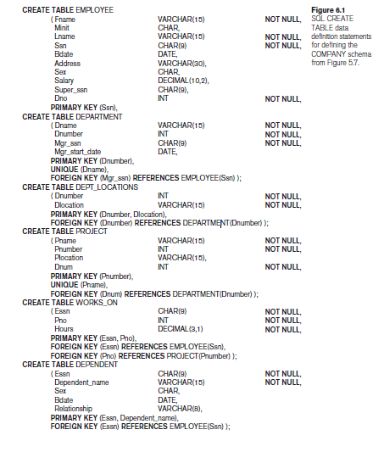
Create tables for Company Database

Slide 7
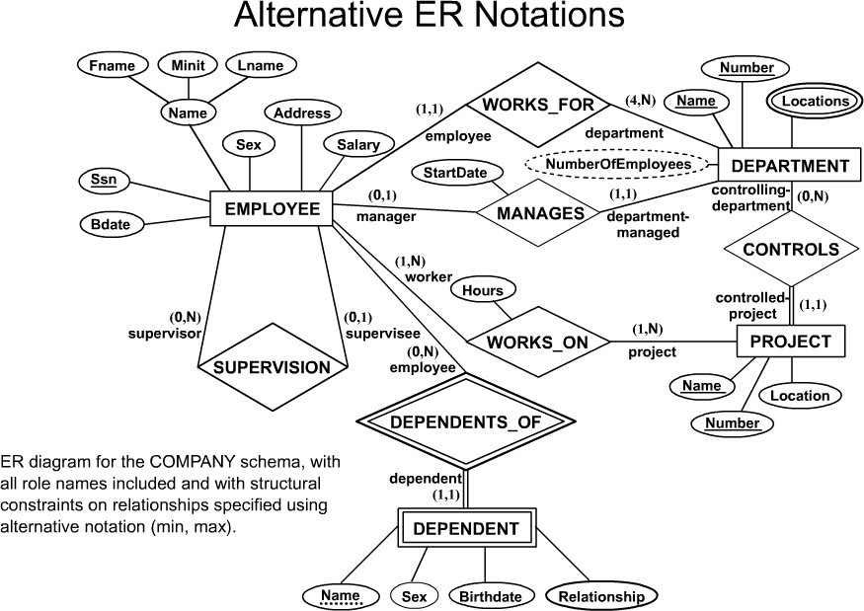
COMPANY ER Schema Diagram

Slide 8
DROP TABLE
Used to remove a relation (base table) and its definition
The relation can no longer be used in queries, updates, or any other commands since its description no longer exists
Example: DROP TABLE DEPENDENT;

Slide 9
ALTER TABLE
Used to add an attribute to one of the base relations
The new attribute will have NULLs in all the tuples of the relation right after the command is executed; hence, the NOT NULL constraint is not allowed for such an attribute
Example: ALTER TABLE EMPLOYEE ADD JOB VARCHAR(12);
The database users must still enter a value for the new attribute JOB for each EMPLOYEE tuple.
This can be done using the UPDATE command.

Slide 10
Attribute Data Types and Domains in SQL
Following broad categories of data types exist in most databases:
String Data
Numeric Data
Temporal Data
Bit String
Boolean

Slide 11
DDL - String Data
Fixed Length:
Occupies the same length of space in memory no matter how much data is stored in them.
Syntax:
char(n) where n is the length of the String
e.g. name char(50)
If the variable stored for name is ‘Presidency’ the extra 40 fields are padded with blanks

Slide 12
DDL - Numeric Data Types
Store all the data related to purely numeric data.
Some numeric data may also be stored as a character field e.g. zip codes
Common Numeric Types:
Decimal Floating point number
Float Floating point number
Integer(size) Integer of specified length
Money A number which contains exactly two digits after the decimal point
Number A standard number field that can hold a floating point data

Slide 13
DDL - Temporal Data Types
These represent the dates and time:
Three basic types are supported:
Dates
Times
Date-Time Combinations
MySQL comes with the following data types for storing a date or a date/time value in the database:
DATE - format YYYY-MM-DD
DATETIME - format: YYYY-MM-DD HH:MI:SS
TIMESTAMP - format: YYYY-MM-DD HH:MI:SS
YEAR - format YYYY or YY

Slide 14
Bit String:
BIT(n)- Fixed Length(n)
BIT varying(n) -Varying length string
Boolean:
Takes value true or false.
Because of the presence of NULL values Boolean also take the value unknown.

Slide 15
Constraints in SQL:
NOT NULL - Ensures that a column cannot have a NULL value
UNIQUE - Ensures that all values in a column are different
PRIMARY KEY - A combination of a NOT NULL and UNIQUE. Uniquely identifies each row in a table
FOREIGN KEY - Uniquely identifies a row/record in another table
CHECK - Ensures that all values in a column satisfies a specific condition
DEFAULT - Sets a default value for a column when no value is specified

Slide 16
DDL - Specifying Keys- Introduction
Unique keyword is used to specify keys.
This ensures that duplicate rows are not created in the database.
Both Primary keys and Candidate Keys can be specified in the database.
Once a set of columns has been declared unique any data entered that duplicates the data in these columns is rejected.
Specifying a single column as unique:

Slide 17
Example:
CREATE TABLE Student
(snum Number,
sname varchar(20),
major varchar(10),
level char(2),
UNIQUE (name));

Slide 18
DDL - Specifying Keys- Multiple Columns
Specifying multiple columns as unique:
Example:
CREATE TABLE Student
(snum Number,
sname varchar(20),
major varchar(10),
level varchar(10),
UNIQUE(snum, sname));
Here both name and snum combination are declared as candidate keys.

Slide 19
DDL - Specifying Keys- Primary Key
Specifying multiple columns as unique:
To specify the Primary Key the Primary Key clause is used
Example:
CREATE TABLE Student
( snum Number,
sname varchar(20),
major varchar(10),
level varchar(10),
DOB DATE,
PRIMARY KEY (snum),
UNIQUE (sname),
);

Slide 20
DDL - Specifying Keys- Single and MultiColumn Keys
Single column keys can be defined at the column level instead of at the table level at the end of the field descriptions.
MultiColumn keys still need to be defined separately at the table level
CREATE TABLE Student
( snum int PRIMARY KEY,
Sname varchar(20) UNIQUE,
major varchar(10),
level varchar(10),
DOB date,
Unique(DOB,MAJOR));

Slide 21
DDL - Specifying Keys- Foreign Keys
References clause is used to create a relationship between a set of columns in one table and a candidate key(primary key) in the table that is being referenced.
Example:
CREATE TABLE ENROLL
( cname varchar(20) references Course(cname) ,
snum int REFERENCES Student(snum));
Creates a relationship between Student and Course.

Slide 22
The Mgr_ssn Example
CREATE TABLE DEPARTMENT (
…
Mgr_ssn CHAR(9),
…
FOREIGN KEY (Mgr_ssn)
REFERENCES EMPLOYEE (Ssn)
ON DELETE ???
ON UPDATE ???
);
Note: Refer the EMP relation in slide no.28

Slide 23
Referential Integrity Options
Causes of referential integrity violation for a foreign key FK (consider the Mgr_ssn of DEPARTMENT).
On Delete: when deleting the foreign tuple
What to do when deleting the manager tuple in EMPLOYEE ?
On Update: when updating the foreign tuple
What to do when updating/changing the SSN of the manager tuple in EMPLOYEE is changed ?
Actions when the above two causes occur.
Set Null: the Mgr_ssn is set to null.
Set Default: the Mgr_ssn is set to the default value.
Cascade: the Mgr_ssn is updated accordingly
If the manager is deleted, the department is also deleted.

Slide 24
Referential Integrity Options
An Example:
Create table EMP( … ESSN CHAR(9), DNO INTEGER DEFAULT 1, SUPERSSN CHAR(9), PRIMARY KEY (ESSN), FOREIGN KEY (DNO) REFERENCES DEPT ON DELETE SET DEFAULT
ON UPDATE CASCADE,
FOREIGN KEY (SUPERSSN) REFERENCES EMP ON DELETE SET NULL ON UPDATE CASCADE);

Slide 25
DDL - Constraints- Disallowing Null Values
Disallowing Null Values:
Null values entered into a column means that the data in not known.
These can cause problems in Querying the database.
Specifying Primary Key automatically prevents null being entered in columns which specify the primary key
Not Null clause is used in preventing null values from being entered in a column.

Slide 26
Example:
CREATE TABLE Student
( snum number PRIMARY KEY,
sname varchar(20) NOT NULL,
major varchar(10) NOT NULL,
level varchar(10) NOT NULL
DOB date);
Null clause can be used to explicitly allow null values in a column also

Slide 27
DDL - Constraints- Value Constraints
Value Constraints:
Allows value inserted in the column to be checked condition in the column constraint.
Check clause is used to create a constraint in SQL
Example:
CREATE TABLE STUDENT
(snum Number PRIMARY KEY,
sname varchar(20),
Age Number check (Age > = 50000));
Table level constraints can also be defined using the Constraint keyword

Slide 28
Example:
CREATE TABLE STUDENT
(SNUM Number PRIMARY KEY,
sname varchar(20) not null,
age Number ,
CONSTRAINT age_constraint Check (age between 17 and 22));
Such constraints can be activated and deactivated as required.

Slide 29
DDL - Constraints- Default Value
Default Value:
A default value can be inserted in any column by using the Default keyword.
Example:
CREATE TABLE STUDENT( SNUM NUMBER NOT NULL UNIQUE PRIMARY KEY, SNAME varchar(20) NOT NULL, MAJOR VARCHAR(10) DEFAULT ‘CSE’, DOB DATE DEFAULT NULL );

Slide 30
DDL -Constraints- AUTO INCREMENT
Auto-increment allows a unique number to be generated automatically when a new record is inserted into a table.
Often this is the primary key field that we would like to be created automatically every time a new record is inserted.
The following SQL statement defines the “SNUM" column to be an auto-increment primary key field in the "Persons" table:
CREATE TABLE STUDENT( SNUM int NOT NULL AUTO_INCREMENT, LastName varchar(255) NOT NULL, FirstName varchar(255), Age int, PRIMARY KEY (SNUM));

Slide 31
continued..
MySQL uses the AUTO_INCREMENT keyword to perform an auto-increment feature.
By default, the starting value for AUTO_INCREMENT is 1, and it will increment by 1 for each new record.
To let the AUTO_INCREMENT sequence start with another value, use the following SQL statement:
ALTER TABLE STUDENT AUTO_INCREMENT=100;
To insert a new record into the “STUDENT" table, we will NOT have to specify a value for the “SNUM" column (a unique value will be added automatically):
INSERT INTO STUDENT (Sname,Major, Level,DOB) VALUES ('Lakshman', ‘IS‘, ’JR’, ‘2001-05-01’);

Slide 32
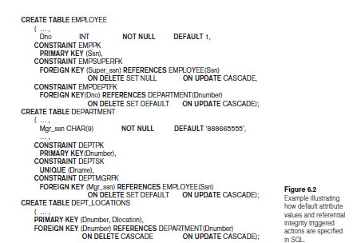

Slide 33
Retrieval Queries in SQL
SQL has one basic statement for retrieving information from a database; the SELECT statement
This is not the same as the SELECT operation of the relational algebra
Important distinction between SQL and the formal relational model:
SQL allows a table (relation) to have two or more tuples that are identical in all their attribute values
Hence, an SQL relation (table) is a multi-set (sometimes called a bag) of tuples; it is not a set of tuples
SQL relations can be constrained to be sets by specifying PRIMARY KEY or UNIQUE attributes, or by using the DISTINCT option in a query

Slide 34
Retrieval Queries in SQL (contd.)
A bag or multi-set is like a set, but an element may appear more than once.
Example: {A, B, C, A} is a bag. {A, B, C} is also a bag that also is a set.
Bags also resemble lists, but the order is irrelevant in a bag.
Example:
{A, B, A} = {B, A, A} as bags
However, [A, B, A] is not equal to [B, A, A] as lists

Slide 35
Retrieval Queries in SQL (contd.)
Basic form of the SQL SELECT statement is called a mapping or a SELECT-FROM-WHERE block
SELECT <attribute list>
FROM <table list>
WHERE <condition>
<attribute list> is a list of attribute names whose values are to be retrieved by the query
<table list> is a list of the relation names required to process the query
<condition> is a conditional (Boolean) expression that identifies the tuples to be retrieved by the query

Slide 36
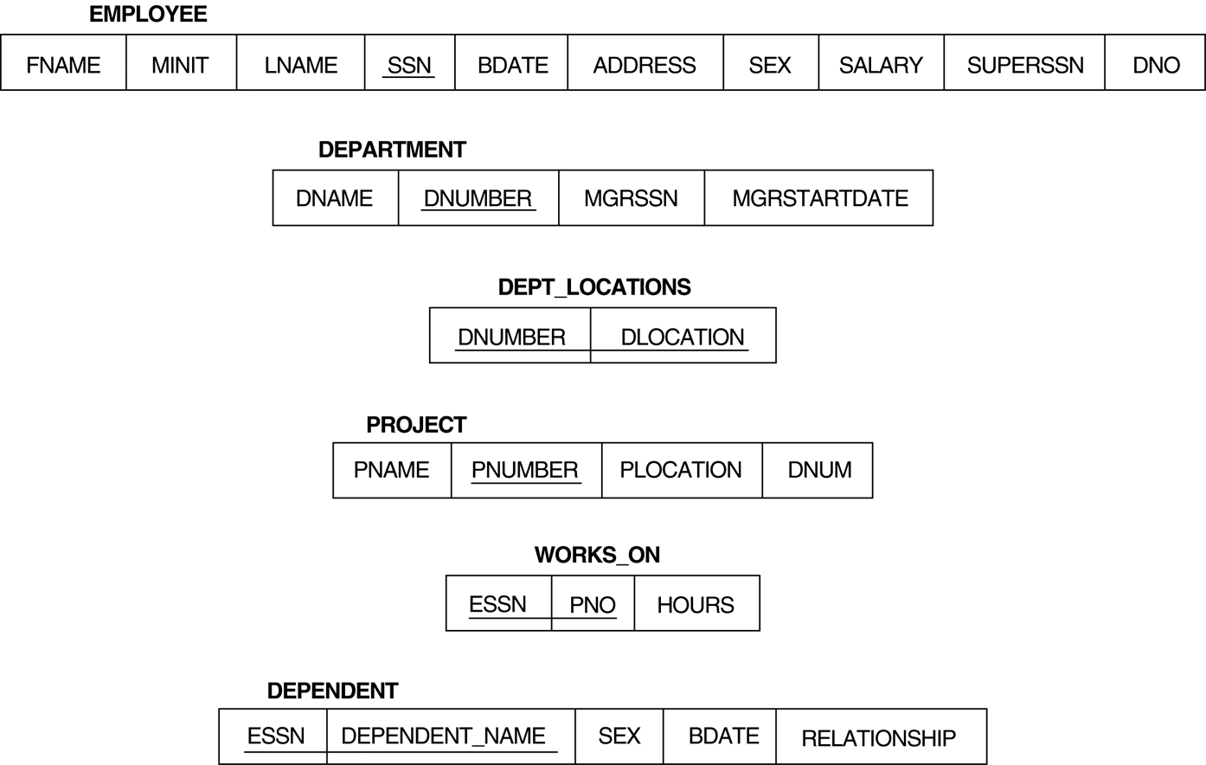
Relational Database Schema

Slide 37
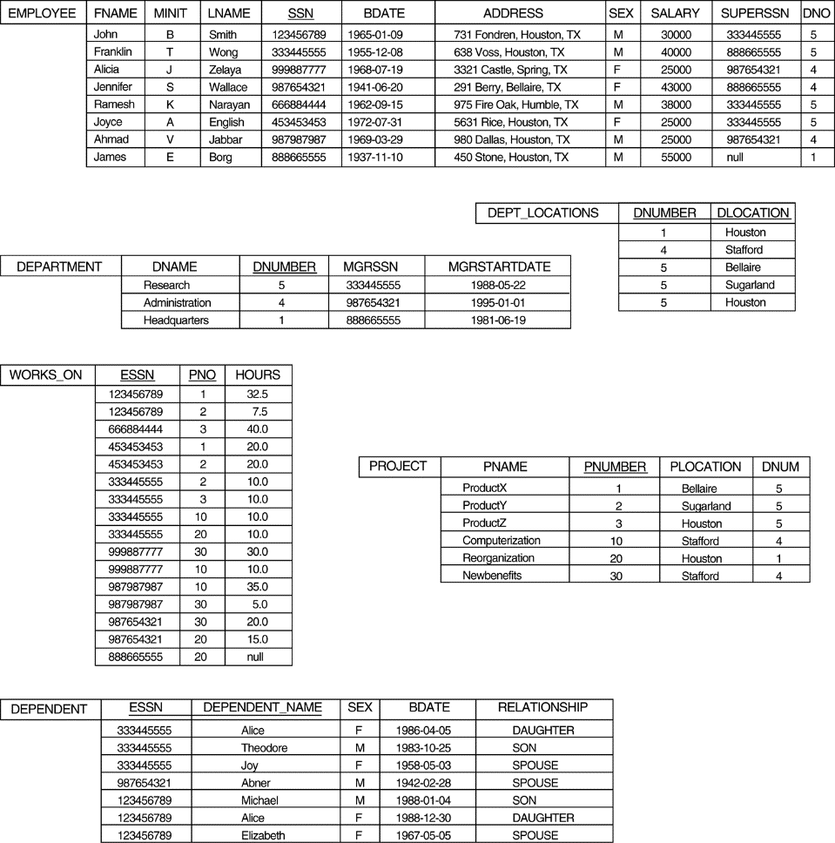
Populated Database

Slide 38
Simple SQL Queries
Basic SQL queries correspond to using the following operations of the relational algebra:
SELECT
PROJECT
JOIN
All subsequent examples use the COMPANY database

Slide 39
Simple SQL Queries (contd.)
Example of a simple query on one relation
Query 0: Retrieve the birthdate and address of the employee whose name is 'John B. Smith'.
Q0: SELECT BDATE, ADDRESS FROM EMPLOYEE WHERE FNAME='John' AND MINIT='B’ AND LNAME='Smith’;
Similar to a SELECT-PROJECT pair of relational algebra operations:
The SELECT-clause specifies the projection attributes and the WHERE-clause specifies the selection condition
However, the result of the query may contain duplicate tuples

Slide 40
Simple SQL Queries (contd.)
Query 1: Retrieve the name and address of all employees who work for the 'Research' department.
Q1: SELECT FNAME, LNAME, ADDRESS FROM EMPLOYEE, DEPARTMENT WHERE DNAME='Research' AND DNUMBER=DNO;
Similar to a SELECT-PROJECT-JOIN sequence of relational algebra operations
(DNAME='Research') is a selection condition (corresponds to a SELECT operation in relational algebra)
(DNUMBER=DNO) is a join condition (corresponds to a JOIN operation in relational algebra)

Slide 41
Simple SQL Queries (contd.)
Query 2: For every project located in 'Stafford', list the project number, the controlling department number, and the department manager's last name, address, and birthdate.
Q2: SELECT PNUMBER, DNUM, LNAME, BDATE, ADDRESS FROM PROJECT, DEPARTMENT, EMPLOYEE WHERE DNUM=DNUMBER AND MGRSSN=SSN AND PLOCATION='Stafford‘;
In Q2, there are two join conditions
The join condition DNUM=DNUMBER relates a project to its controlling department
The join condition MGRSSN=SSN relates the controlling department to the employee who manages that department.

Slide 42
Aliases, * and DISTINCT, Empty WHERE-clause
In SQL, we can use the same name for two (or more) attributes as long as the attributes are in different relations
A query that refers to two or more attributes with the same name must qualify the attribute name with the relation name by prefixing the relation name to the attribute name
Example:
EMPLOYEE.LNAME, DEPARTMENT.DNAME

Slide 43
ALIASES
Some queries need to refer to the same relation twice
In this case, aliases are given to the relation name
Query 8: For each employee, retrieve the employee's name, and the name of his or her immediate supervisor. Q8: SELECT E.FNAME, E.LNAME, S.FNAME, S.LNAME FROM EMPLOYEE E S WHERE E.SUPERSSN=S.SSN;
In Q8, the alternate relation names E and S are called aliases or tuple variables for the EMPLOYEE relation
We can think of E and S as two different copies of EMPLOYEE; E represents employees in role of supervisees and S represents employees in role of supervisors

Slide 44
ALIASES (contd.)
Aliasing can also be used in any SQL query for convenience
Can also use the AS keyword to specify aliases
Q8: SELECT E.FNAME, E.LNAME, S.FNAME, S.LNAME FROM EMPLOYEE AS E, EMPLOYEE AS S WHERE E.SUPERSSN=S.SSN;

Slide 45
UNSPECIFIED WHERE-clause
A missing WHERE-clause indicates no condition; hence, all tuples of the relations in the FROM-clause are selected
This is equivalent to the condition WHERE TRUE
Query 9: Retrieve the SSN values for all employees.
Q9: SELECT SSN FROM EMPLOYEE;
If more than one relation is specified in the FROM-clause and there is no join condition, then the CARTESIAN PRODUCT of tuples is selected

Slide 46
UNSPECIFIED WHERE-clause (contd.)
Example:
Q10: SELECT SSN, DNAME FROM EMPLOYEE, DEPARTMENT;
It is extremely important not to overlook specifying any selection and join conditions in the WHERE-clause; otherwise, incorrect and very large relations may result

Slide 47
USE OF *
To retrieve all the attribute values of the selected tuples, a * is used, which stands for all the attributes Examples:
Q1C: SELECT * FROM EMPLOYEE WHERE DNO=5; Q1D: SELECT * FROM EMPLOYEE, DEPARTMENT WHERE DNAME='Research' AND DNO=DNUMBER;

Slide 48
USE OF DISTINCT
SQL does not treat a relation as a set; duplicate tuples can appear
To eliminate duplicate tuples in a query result, the keyword DISTINCT is used
For example, the result of Q11 may have duplicate SALARY values whereas Q11A does not have any duplicate values
Q11: SELECT ALL SALARY FROM EMPLOYEE; Q11A: SELECT DISTINCT SALARY FROM EMPLOYEE;

Slide 49
SET OPERATIONS
SQL has directly incorporated some set operations
There is a union operation (UNION), and in some versions of SQL there are set difference (MINUS) and intersection (INTERSECT) operations
The resulting relations of these set operations are sets of tuples; duplicate tuples are eliminated from the result
The set operations apply only to union compatible relations; the two relations must have the same attributes and the attributes must appear in the same order

Slide 50
SET OPERATIONS (contd.)
Query 4: Make a list of all project numbers for projects that involve an employee whose last name is 'Smith' as a worker or as a manager of the department that controls the project.
Q4: (SELECT DISTINCT PNUMBER FROM PROJECT, DEPARTMENT, EMPLOYEE WHERE DNUM=DNUMBER AND MGRSSN=SSN AND LNAME='Smith') UNION
(SELECT PNUMBER FROM PROJECT, WORKS_ON, EMPLOYEE WHERE PNUMBER=PNO AND
ESSN=SSN AND NAME='Smith');

Slide 51
SUBSTRING PATTERN MATCHING AND ARITHMATIC OPERATORS
In SQL, the LIKE comparison operator is used for string pattern matching.
Partial strings are specified used two reserved characters:
- % replaces an arbitrary number of zero or more characters.
- Underscore(_) replaces a single character.
Q12: Retreive all employees whose address is in Houston, Texas.
SELECT Fname, Lname
FROM Employee
WHERE Address LIKE ‘%Houston,Tex%’;

Slide 52
Q12A: Find all the employees who were born during the 1950s.
SELECT Fname, Lname
FROM Employee
WHERE Bdate LIKE ‘_ _ 5_ _ _ _ _ _ _’;
Q13: Show the resulting salaries if every employee working on the ‘ProductX’ project is given a 10% rise.
SELECT E.Fname, E.Lname, 1.1*E.Salary AS Increased_Salary
FROM Employee AS E, Works_On AS W, Project AS P
WHERE E.SSN = W.ESSN and W.Pno = P.Pno and P.Pname = ‘ProductX’;
Q14: Retrieve all employees in dept. No 5 whose salary is between $30000 and $40000.
SELECT * FROM Employee WHERE (Salary BETWEEN 30000 AND 40000) AND Dno = 5;

Slide 53
ORDER BY
The ORDER BY clause is used to sort the tuples in a query result based on the values of some attribute(s)
Query 28: Retrieve a list of employees and the projects each works in, ordered by the employee's department, and within each department ordered alphabetically by employee last name.
Q28: SELECT DNAME, LNAME, FNAME, PNAME FROM DEPARTMENT, EMPLOYEE, WORKS_ON, PROJECT WHERE DNUMBER=DNO AND SSN=ESSN AND PNO=PNUMBER ORDER BY DNAME, LNAME;

Slide 54
ORDER BY (contd.)
The default order is in ascending order of values
We can specify the keyword DESC if we want a descending order; the keyword ASC can be used to explicitly specify ascending order, even though it is the default

Slide 55
INSERT
In its simplest form, it is used to add one or more tuples to a relation
Attribute values should be listed in the same order as the attributes were specified in the CREATE TABLE command

Slide 56
INSERT (contd.)
Example:
U1: INSERT INTO EMPLOYEE VALUES ('Richard','K','Marini', '653298653', '30-DEC-52', '98 Oak Forest,Katy,TX', 'M', 37000,'987654321', 4 );
An alternate form of INSERT specifies explicitly the attribute names that correspond to the values in the new tuple
Attributes with NULL values can be left out
Example: Insert a tuple for a new EMPLOYEE for whom we only know the FNAME, LNAME, and SSN attributes.
U1A: INSERT INTO EMPLOYEE (FNAME, LNAME, SSN) VALUES ('Richard', 'Marini', '653298653');

Slide 57
INSERT (contd.)
Important Note: Only the constraints specified in the DDL commands are automatically enforced by the DBMS when updates are applied to the database
Another variation of INSERT allows insertion of multiple tuples resulting from a query into a relation

Slide 58
INSERT (contd.)
Example: Suppose we want to create a temporary table that has the name, number of employees, and total salaries for each department.
A table DEPTS_INFO is created by U3A, and is loaded with the summary information retrieved from the database by the query in U3B.
U3A: CREATE TABLE DEPTS_INFO (DEPT_NAME VARCHAR(10), NO_OF_EMPS INTEGER, TOTAL_SAL INTEGER);
U3B: INSERT INTO DEPTS_INFO (DEPT_NAME, NO_OF_EMPS, TOTAL_SAL) SELECT DNAME, COUNT (*), SUM (SALARY) FROM DEPARTMENT, EMPLOYEE WHERE DNUMBER=DNO GROUP BY DNAME ;

Slide 59
INSERT (contd.)
Note: The DEPTS_INFO table may not be up-to-date if we change the tuples in either the DEPARTMENT or the EMPLOYEE relations after issuing U3B. We have to create a view (see later) to keep such a table up to date.

Slide 60
DELETE
Removes tuples from a relation
Includes a WHERE-clause to select the tuples to be deleted
Referential integrity should be enforced
Tuples are deleted from only one table at a time (unless CASCADE is specified on a referential integrity constraint)
A missing WHERE-clause specifies that all tuples in the relation are to be deleted; the table then becomes an empty table
The number of tuples deleted depends on the number of tuples in the relation that satisfy the WHERE-clause

Slide 61
DELETE (contd.)
Examples:
U4A: DELETE FROM EMPLOYEE WHERE LNAME='Brown’;
U4B: DELETE FROM EMPLOYEE WHERE SSN='123456789’;
U4C: DELETE FROM EMPLOYEE WHERE DNO IN (SELECT DNUMBER FROM DEPARTMENT WHERE DNAME='Research');
U4D: DELETE FROM EMPLOYEE;

Slide 62
UPDATE
Used to modify attribute values of one or more selected tuples
A WHERE-clause selects the tuples to be modified
An additional SET-clause specifies the attributes to be modified and their new values
Each command modifies tuples in the same relation
Referential integrity should be enforced

Slide 63
UPDATE (contd.)
Example: Change the location and controlling department number of project number 10 to 'Bellaire' and 5, respectively.
U5: UPDATE PROJECT SET PLOCATION = 'Bellaire', DNUM = 5
WHERE PNUMBER=10;

Slide 64
UPDATE (contd.)
Example: Give all employees in the 'Research' department a 10% raise in salary.
U6: UPDATE EMPLOYEE SET SALARY = SALARY *1.1 WHERE DNO IN (SELECT DNUMBER FROM DEPARTMENT
WHERE DNAME='Research');
In this request, the modified SALARY value depends on the original SALARY value in each tuple
The reference to the SALARY attribute on the right of = refers to the old SALARY value before modification
The reference to the SALARY attribute on the left of = refers to the new SALARY value after modification

Slide 65
MORE COMPLEX SQL RETRIEVAL QUERIES

Slide 66
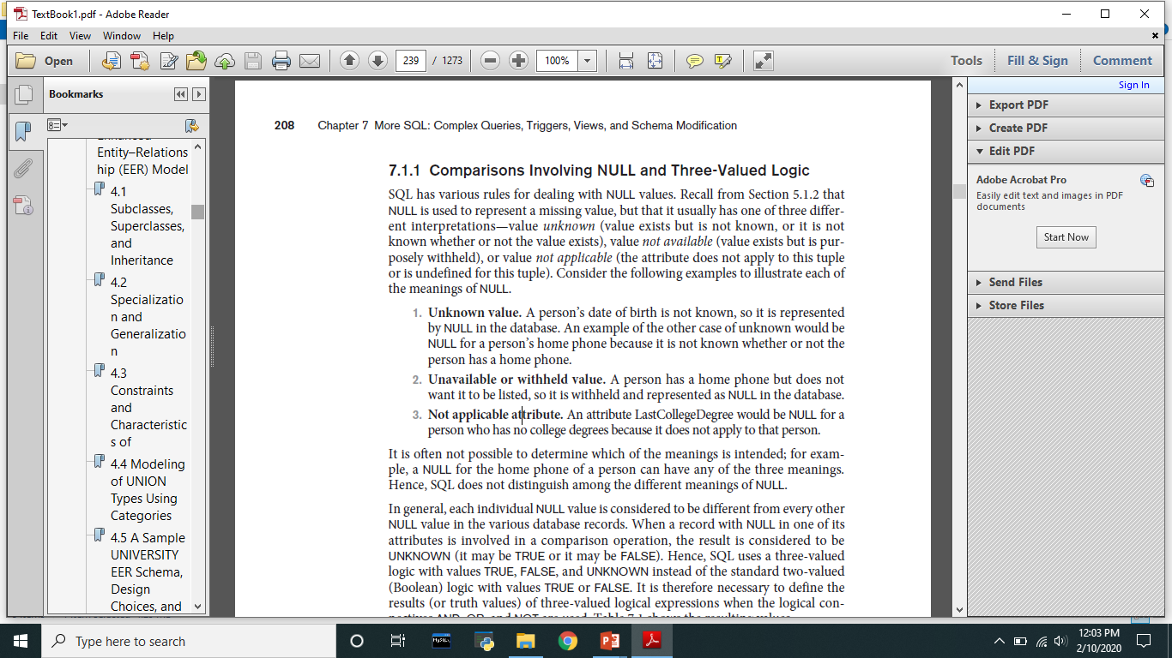
COMPARISON INVOLVING NULL AND 3 VALUED LOGIC
SQL has various rules for dealing with NULL values. The NULL is used to represent a missing values but that is usually has one of the 3 different interpretations

Slide 67
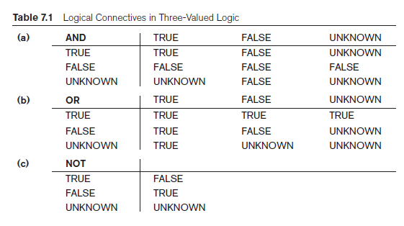
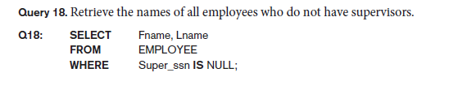

Slide 68
Populated Database

Slide 69
NESTING OF QUERIES
A complete SELECT query, called a nested query, can be specified within the WHERE-clause of another query, called the outer query
Many of the previous queries can be specified in an alternative form using nesting
Query 1: Retrieve the name and address of all employees who work for the 'Research' department.
Q1: SELECT FNAME, LNAME, ADDRESS FROM EMPLOYEE WHERE DNO IN (SELECT DNUMBER FROM DEPARTMENT WHERE DNAME='Research' );

Slide 70
NESTING OF QUERIES (contd.)
The nested query selects the number of the 'Research' department
The outer query select an EMPLOYEE tuple if its DNO value is in the result of either nested query
The comparison operator IN compares a value v with a set (or multi-set) of values V, and evaluates to TRUE if v is one of the elements in V
In general, we can have several levels of nested queries
A reference to an unqualified attribute refers to the relation declared in the innermost nested query
In this example, the nested query is not correlated with the outer query

Slide 71
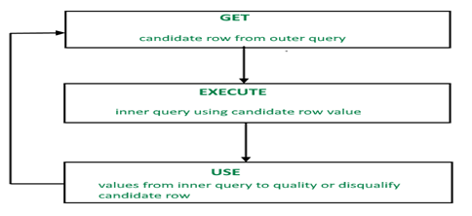
CORRELATED NESTED QUERIES
If a condition in the WHERE-clause of a nested query references an attribute of a relation declared in the outer query, the two queries are said to be correlated
The result of a correlated nested query is different for each tuple (or combination of tuples) of the relation(s) the outer query
Query 12: Retrieve the name of each employee who has a dependent with the same first name as the employee. Q12: SELECT E.FNAME, E.LNAME FROM EMPLOYEE AS E WHERE E.SSN IN (SELECT D.ESSN FROM DEPENDENT AS D WHERE E.ESSN=E.SSN AND E.FNAME=DEPENDENT_NAME);

Slide 72
CORRELATED NESTED QUERIES (contd.)
In Q12, the nested query has a different result in the outer query
A query written with nested SELECT... FROM... WHERE... blocks and using the = or IN comparison operators can always be expressed as a single block query. For example, Q12 may be written as in Q12A Q12A: SELECT E.FNAME, E.LNAME FROM EMPLOYEE E, DEPENDENT D WHERE E.SSN=D.ESSN AND E.FNAME=D.DEPENDENT_NAME;
Nested Subqueries Versus Correlated Subqueries :
With a normal nested subquery, the inner SELECT query runs first and executes once, returning values to be used by the main query. A correlated subquery, however, executes once for each candidate row considered by the outer query. In other words, the inner query is driven by the outer query.

Slide 73
CORRELATED NESTED QUERIES (contd.)
The original SQL as specified for SYSTEM R also had a CONTAINS comparison operator, which is used in conjunction with nested correlated queries
This operator was dropped from the language, possibly because of the difficulty in implementing it efficiently
Most implementations of SQL do not have this operator
The CONTAINS operator compares two sets of values, and returns TRUE if one set contains all values in the other set
Reminiscent of the division operation of algebra

Slide 74
CORRELATED NESTED QUERIES (contd.)
Query 3: Retrieve the name of each employee who works on all the projects controlled by department number 5.
Q3: SELECT FNAME, LNAME FROM EMPLOYEE WHERE ( (SELECT PNO FROM WORKS_ON WHERE SSN=ESSN) CONTAINS (SELECT PNUMBER FROM PROJECT WHERE DNUM=5) );

Slide 75
CORRELATED NESTED QUERIES (contd.)
In Q3, the second nested query, which is not correlated with the outer query, retrieves the project numbers of all projects controlled by department 5
The first nested query, which is correlated, retrieves the project numbers on which the employee works, which is different for each employee tuple because of the correlation

Slide 76
THE EXISTS FUNCTION
EXISTS is used to check whether the result of a correlated nested query is empty (contains no tuples) or not
The result of EXISTS is a boolean value True or False. It can be used in a SELECT, UPDATE, INSERT or DELETE statement.
SELECT column_name(s) FROM table_name WHERE EXISTS
(SELECT column_name(s) FROM table_name WHERE condition);
We can formulate Query 12 in an alternative form that uses EXISTS as Q12B

Slide 77
THE EXISTS FUNCTION (contd.)
Query 12: Retrieve the name of each employee who has a dependent with the same first name as the employee.
Q12B: SELECT FNAME, LNAME FROM EMPLOYEE WHERE EXISTS (SELECT * FROM DEPENDENT WHERE SSN=ESSN AND FNAME=DEPENDENT_NAME);

Slide 78
THE EXISTS FUNCTION (contd.)
Query 6: Retrieve the names of employees who have no dependents.
Q6: SELECT FNAME, LNAME FROM EMPLOYEE WHERE NOT EXISTS (SELECT * FROM DEPENDENT WHERE SSN=ESSN);
In Q6, the correlated nested query retrieves all DEPENDENT tuples related to an EMPLOYEE tuple. If none exist, the EMPLOYEE tuple is selected
EXISTS is necessary for the expressive power of SQL

Slide 79
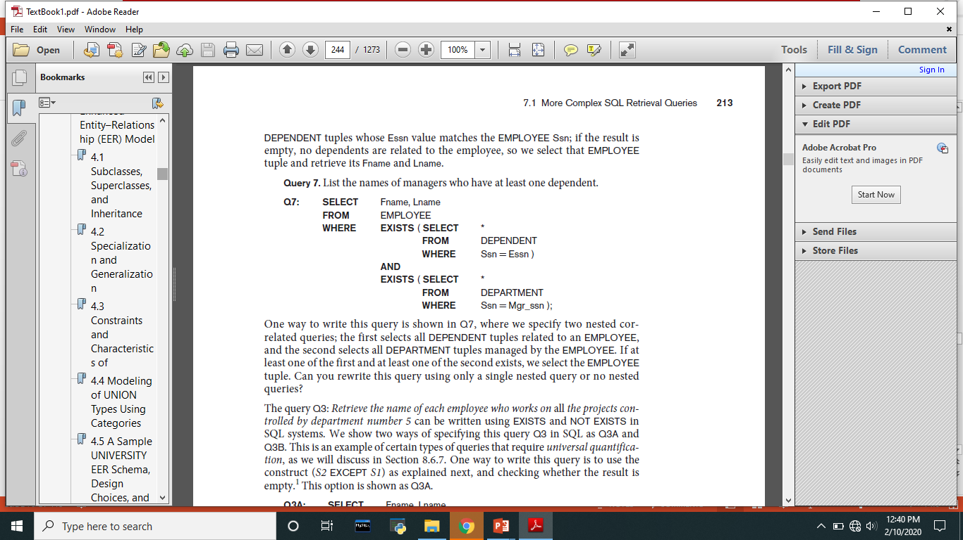
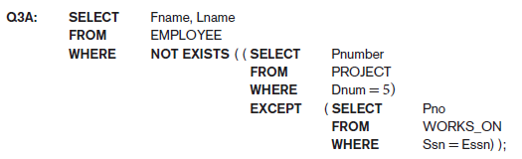

Slide 80
EXPLICIT SETS
It is also possible to use an explicit (enumerated) set of values in the WHERE-clause rather than a nested query
Query 13: Retrieve the social security numbers of all employees who work on project number 1, 2, or 3.
Q13: SELECT DISTINCT ESSN FROM WORKS_ON WHERE PNO IN (1, 2, 3);

Slide 81
Joined Relations Feature in SQL
Can specify a "joined relation" in the FROM-clause
Looks like any other relation but is the result of a join
Allows the user to specify different types of joins (regular "theta" JOIN, NATURAL JOIN, LEFT OUTER JOIN, RIGHT OUTER JOIN, CROSS JOIN, etc)

Slide 82
Joined Relations Feature in SQL (contd.)
Examples:
Q8: SELECT E.FNAME, E.LNAME, S.FNAME, S.LNAME FROM EMPLOYEE E S WHERE E.SUPERSSN=S.SSN;
can be written as:
Q8: SELECT E.FNAME, E.LNAME, S.FNAME, S.LNAME FROM (EMPLOYEE E LEFT OUTER JOIN EMPLOYEES ON E.SUPERSSN=S.SSN);

Slide 83
Joined Relations Feature in SQL (contd.)
Examples:
Q1: SELECT FNAME, LNAME, ADDRESS FROM EMPLOYEE, DEPARTMENT WHERE DNAME='Research' AND DNUMBER=DNO;
could be written as:
Q1: SELECT FNAME, LNAME, ADDRESS FROM (EMPLOYEE JOIN DEPARTMENT ON DNUMBER=DNO) WHERE DNAME='Research’;
or as:
Q1: SELECT FNAME, LNAME, ADDRESS FROM (EMPLOYEE NATURAL JOIN DEPARTMENT AS DEPT(DNAME, DNO, MSSN, MSDATE) WHERE DNAME='Research’;

Slide 84
Joined Relations Feature in SQL(contd.)
Another Example: Q2 could be written as follows; this illustrates multiple joins in the joined tables
Q2: SELECT PNUMBER, DNUM, LNAME, BDATE, ADDRESS FROM (PROJECT JOIN DEPARTMENT ON DNUM=DNUMBER)
JOIN EMPLOYEE ON MGRSSN=SSN) ) WHERE PLOCATION='Stafford’;

Slide 85
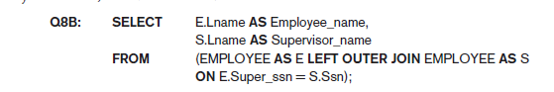
Illustration for LEFT OUTER JOIN

Slide 86
AGGREGATE FUNCTIONS
Include COUNT, SUM, MAX, MIN, and AVG
Query 15: Find the maximum salary, the minimum salary, and the average salary among all employees.
Q15: SELECT MAX(SALARY), MIN(SALARY), AVG(SALARY), SUM(SALARY) FROM EMPLOYEE;
Some SQL implementations may not allow more than one function in the SELECT-clause

Slide 87
AGGREGATE FUNCTIONS (contd.)
Query 16: Find the maximum salary, the minimum salary, and the average salary among employees who work for the 'Research' department.
Q16: SELECT MAX(SALARY), MIN(SALARY), AVG(SALARY) FROM EMPLOYEE, DEPARTMENT WHERE DNO=DNUMBER AND DNAME='Research‘;

Slide 88
AGGREGATE FUNCTIONS (contd.)
Queries 17 and 18: Retrieve the total number of employees in the company (Q17), and the number of employees in the 'Research' department (Q18).
Q17: SELECT COUNT (*) FROM EMPLOYEE;
Q18: SELECT COUNT (*) FROM EMPLOYEE, DEPARTMENT WHERE DNO=DNUMBER AND DNAME='Research’;

Slide 89
GROUPING
In many cases, we want to apply the aggregate functions to subgroups of tuples in a relation
Each subgroup of tuples consists of the set of tuples that have the same value for the grouping attribute(s)
The function is applied to each subgroup independently
SQL has a GROUP BY-clause for specifying the grouping attributes, which must also appear in the SELECT-clause

Slide 90
GROUPING (contd.)
Query 20: For each department, retrieve the department number, the number of employees in the department, and their average salary.
Q20: SELECT DNO, COUNT (*), AVG (SALARY) FROM EMPLOYEE GROUP BY DNO;
In Q20, the EMPLOYEE tuples are divided into groups-
Each group having the same value for the grouping attribute DNO
The COUNT and AVG functions are applied to each such group of tuples separately
The SELECT-clause includes only the grouping attribute and the functions to be applied on each group of tuples
A join condition can be used in conjunction with grouping

Slide 91
GROUPING (contd.)
Query 21: For each project, retrieve the project number, project name, and the number of employees who work on that project.
Q21: SELECT PNUMBER, PNAME, COUNT (*) FROM PROJECT, WORKS_ON WHERE PNUMBER=PNO GROUP BY PNUMBER, PNAME;
In this case, the grouping and functions are applied after the joining of the two relations

Slide 92
THE HAVING-CLAUSE
Sometimes we want to retrieve the values of these functions for only those groups that satisfy certain conditions
The HAVING-clause is used for specifying a selection condition on groups (rather than on individual tuples)

Slide 93
THE HAVING-CLAUSE (contd.)
Query 22: For each project on which more than two employees work, retrieve the project number, project name, and the number of employees who work on that project.
Q22: SELECT PNUMBER, PNAME, COUNT(*) FROM PROJECT, WORKS_ON WHERE PNUMBER=PNO GROUP BY PNUMBER, PNAME HAVING COUNT (*) > 2;

Slide 94
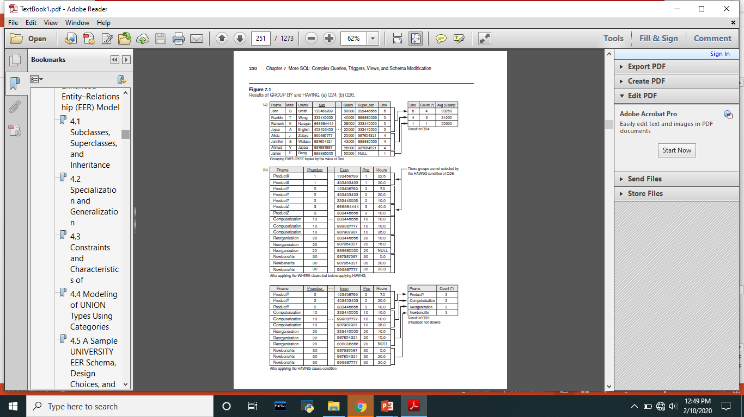
COUNT(*) returns the number of rows in a specified table, and it preserves duplicate rows. It counts each row separately. This includes rows that contain null values.

Slide 95
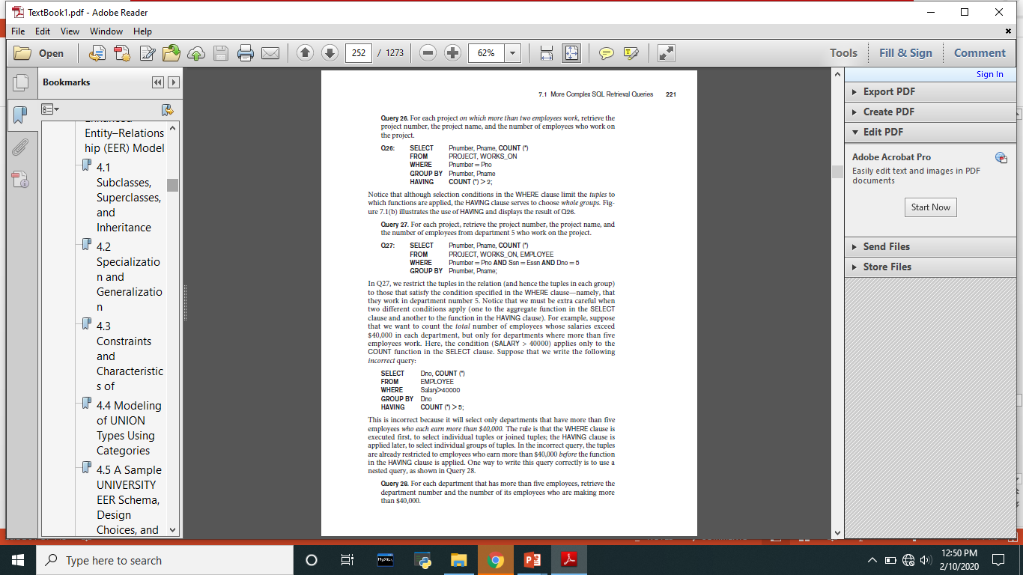

Slide 96
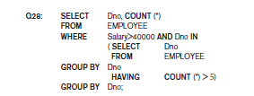

Slide 97
ORDER BY
The ORDER BY clause is used to sort the tuples in a query result based on the values of some attribute(s)
Query 28: Retrieve a list of employees and the projects each works in, ordered by the employee's department, and within each department ordered alphabetically by employee last name.
Q28: SELECT DNAME, LNAME, FNAME, PNAME FROM DEPARTMENT, EMPLOYEE, WORKS_ON, PROJECT WHERE DNUMBER=DNO AND SSN=ESSN AND PNO=PNUMBER ORDER BY DNAME, LNAME;

Slide 98
ORDER BY (contd.)
The default order is in ascending order of values
We can specify the keyword DESC if we want a descending order; the keyword ASC can be used to explicitly specify ascending order, even though it is the default

Slide 99
Constraints as Assertions
General constraints: constraints that do not fit in the basic SQL categories (presented in chapter 8)
Mechanism: CREATE ASSERTION
Components include:
a constraint name,
followed by CHECK,
followed by a condition

Slide 100
Assertions: An Example
“The salary of an employee must not be greater than the salary of the manager of the department that the employee works for’’
CREATE ASSERTION SALARY_CONSTRAINT
CHECK (NOT EXISTS (SELECT *
FROM EMPLOYEE E, EMPLOYEE M, DEPARTMENT D
WHERE E.SALARY > M.SALARY AND
E.DNO=D.NUMBER AND D.MGRSSN=M.SSN));

Slide 101
SQL Triggers
Objective: to monitor a database and take initiate action when a condition occurs
A trigger is a stored procedure in database which automatically invokes whenever a special event in the database occurs. For example, a trigger can be invoked when a row is inserted into a specified table or when certain table columns are being updated.
Triggers are expressed in a syntax similar to assertions and include the following:
Event
Such as an insert, deleted, or update operation
BEFORE or AFTER the triggering operation is executed
Condition: Determines whether the rule action should be executed.
Optional Condition: If Condition exists
If no condition exists
Action
To be taken when the condition is satisfied

Slide 102
Syntax
create [or replace ] trigger [trigger_name] //Creates or replaces an existing trigger with the trigger_name.
[before | after] //This specifies when the trigger will be executed.
{insert | update | delete} //This specifies the DML operation.
on [table_name] //This specifies the name of the table associated with the trigger.
[for each row] //This specifies a row-level trigger, i.e., the trigger will be executed for each row being affected.
[trigger_body] //This provides the operation to be performed as trigger is fired

Slide 103
Example:
Given Student Report Database, in which student marks assessment is recorded. In such schema, create a trigger so that the total and average of specified marks is automatically inserted whenever a record is insert.
mysql> desc Student;
+-------+-------------+------+-----+---------+----------------+
| Field | Type | Null | Key | Default | Extra |
+-------+-------------+------+-----+---------+----------------+
| tid | int(4) | NO | PRI | NULL | auto_increment |
| name | varchar(30) | YES | | NULL| |
| subj1 | int(2) | YES | | NULL | |
| subj2 | int(2) | YES | | NULL | |
| subj3 | int(2) | YES | | NULL | |
| total | int(3) | YES | | NULL | |
| avg | int(3) | YES | | NULL | |
+-------+-------------+------+-----+---------+----------------+

Slide 104
Example:
Create trigger stumarks
Before insert on student for each row set student.total=student.sub1+student.sub2+student.sub3,
Student.avg=student.total/3;
mysql> insert into Student values(0, “Ram", 20, 20, 20, 0, 0);
Query OK, 1 row affected (0.09 sec)

Slide 105
mysql> select * from Student;
+-----+-------+-------+-------+-------+-------+------+
| tid | name | subj1 | subj2 | subj3 | total | avg |
+-----+-------+-------+-------+-------+-------+------+
| 100 | Ram | 20 | 20 | 20 | 60 | 20 |
+-----+-------+-------+-------+-------+-------+------+
1 row in set (0.00 sec)

Slide 106
Example
Given Library Book Management database schema with Student database schema. In these databases, if any student borrows a book from library then the count of that specified book should be decremented.
mysql> select * from book_det;
+-----+-------------+--------+
| bid | btitle | copies |
+-----+-------------+--------+
| 1 | Java | 10 |
| 2 | C++ | 5 |
| 3 | MySql | 10|
| 4 | DBMS | 5 |
+-----+-------------+--------+
4 rows in set (0.00 sec)
mysql> select * from book_issue;
+------+------+--------+
| bid | sid | btitle |
+------+------+--------+
1 row in set (0.00 sec)

Slide 107
OLD and NEW.
There is two MySQL extension to triggers 'OLD' and 'NEW'.
OLD and NEW are not case sensitive.
Within the trigger body, the OLD and NEW keywords enable you to access columns in the rows affected by a trigger
In an INSERT trigger, only NEW.col_name can be used.
In a UPDATE trigger, you can use OLD.col_name to refer to the columns of a row before it is updated and NEW.col_name to refer to the columns of the row after it is updated.
In a DELETE trigger, only OLD.col_name can be used; there is no new row.

Slide 108
Example
mysql> insert into book_issue values(1, 100, "Java");
mysql> select * from book_det;
+-----+-------------+--------+
| bid | btitle | copies |
+-----+-------------+--------+
| 1 | Java | 9 |
| 2 | C++ | 5 |
| 3 | MySql | 10 |
| 4 | DBMS | 5 |
+-----+-------------+--------+
mysql> select * from book_issue;
+------+------+--------+
| bid | sid | btitle |
+------+------+--------+
| 1 | 100 | Java |
+------+------+--------+
Create or replace trigger book_deduction
After insert on book_issue for each row update book_det set copies=copies-1 where bid=new.bid;

Slide 109
Populated Database

Slide 110
SQL Triggers: An Example
A trigger to compare an employee’s salary to his/her supervisor during insert or update operations:
CREATE TRIGGER INFORM_SUPERVISOR
BEFORE INSERT OR UPDATE OF SALARY, SUPERVISOR_SSN ON EMPLOYEE
FOR EACH ROW
WHEN
(NEW.SALARY> (SELECT SALARY FROM EMPLOYEE
WHERE SSN=NEW.SUPERVISOR_SSN))
INFORM_SUPERVISOR (NEW.SUPERVISOR_SSN,NEW.SSN);

Slide 111
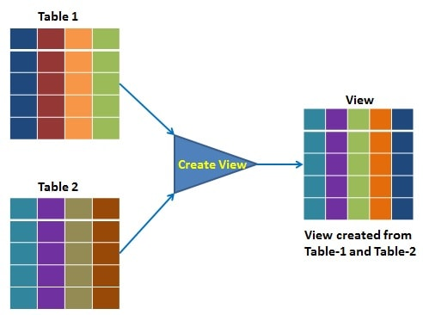
Views in SQL
A view is a “virtual” table that is derived from other tables
Allows for limited update operations
Since the table may not physically be stored
Allows full query operations
A convenience for expressing certain operations

Slide 112
Specification of Views
The view has primarily two purposes:
Simplify the complex SQL queries.
Provide restriction to users from accessing sensitive data.
SQL command: CREATE VIEW
a table (view) name
a possible list of attribute names (for example, when arithmetic operations are specified or when we want the names to be different from the attributes in the base relations)
a query to specify the table contents

Slide 113
Views in SQL
Deptname | Empname | Salary
Admin | XYZ | 20000
HR | PQR | 16000
Accounts | ABC | 13000
Department table
VHR----- HR
VADMIN- --- ADMIN
Create view VHR as select deptname,empname,salary where deptname=‘HR’;
Select * from VHR;

Slide 114
Example
Department Employee empbydept
Create view empbydept as
Select emp.id,emp.name,emp.salary,emp.gender,dept.d_name from emp join dept on emp.d_id=dept.d_id;
Select * from empbydept;
D_id | D_name
1 | IT
2 | Accounts
3 | HR
4 | Admin
Id | Name | Salary | Gender | D_id
1 | Aman | 6000 | Male | 3
2 | Bhavya | 4999 | Female | 2
3 | Chang | 7000 | Male | 1
4 | Deep | 5000 | Male | 4
5 | Ekta | 3500 | Female | 3
6 | Francis | 4500 | Male | 1
Id | Name | Salary | Gender | D_name
1 | Aman | 6000 | Male | HR
2 | Bhavya | 4999 | Female | Accounts
3 | Chang | 7000 | Male | IT
4 | Deep | 5000 | Male | Admin
5 | Ekta | 3500 | Female | HR
6 | Francis | 4500 | Male | IT

Slide 115
Create view Itemp as select id,name,salary,gender,d_name from emp join dept in emp.d_id= dept.d_id where dept.d_name=‘IT’;
Select * from Itemp;
Create view nonconfidentialdata as select name,gender,d_name from emp join dept in emp.d_id= dept.d_id ;
Create view summery as select d_name,count(id) as total_emp from emp join dept on dept.d_id=emp.d_id group by d_name;

Slide 116
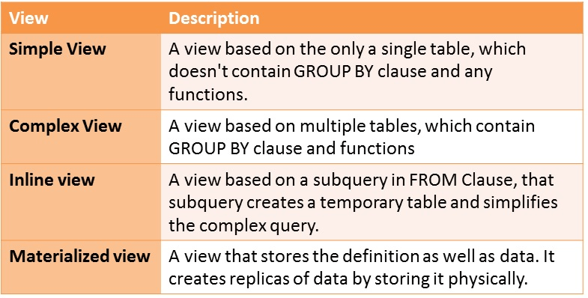
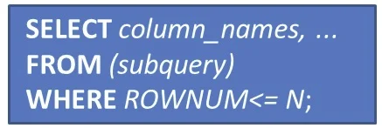
Types of View

Slide 117
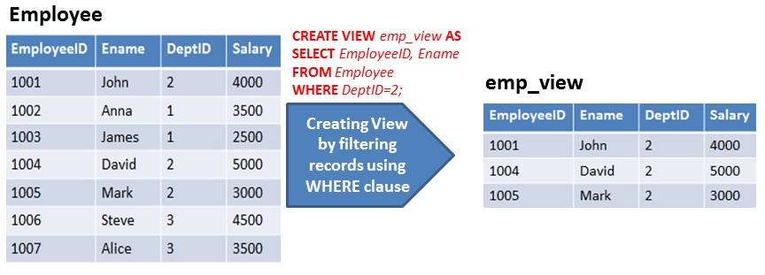
Simple View

Slide 118
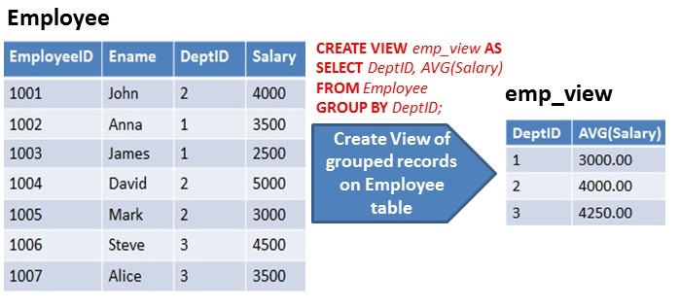
Complex View

Slide 119
SQL Views: An Example
Specify a different WORKS_ON table
CREATE VIEW WORKS_ON_NEW AS
SELECT FNAME, LNAME, PNAME, HOURS
FROM EMPLOYEE, PROJECT, WORKS_ON
WHERE SSN=ESSN AND PNO=PNUMBER
GROUP BY PNAME;

Slide 120
Using a Virtual Table
We can specify SQL queries on a newly create table (view):
SELECT FNAME, LNAME
FROM WORKS_ON_NEW
WHERE PNAME=‘Seena’;
When no longer needed, a view can be dropped:
DROP WORKS_ON_NEW;

Slide 121
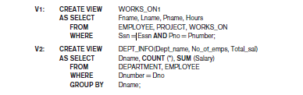
VIEWS Example

Slide 122
Efficient View Implementation
Query modification:
Present the view query in terms of a query on the underlying base tables
Disadvantage:
Inefficient for views defined via complex queries
Especially if additional queries are to be applied to the view within a short time period

Slide 123
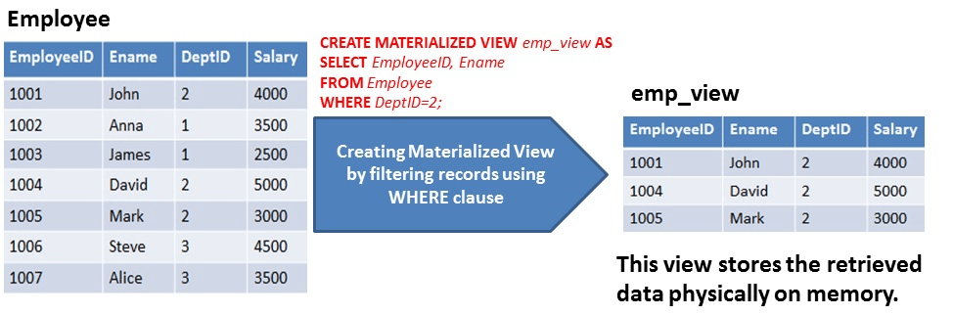
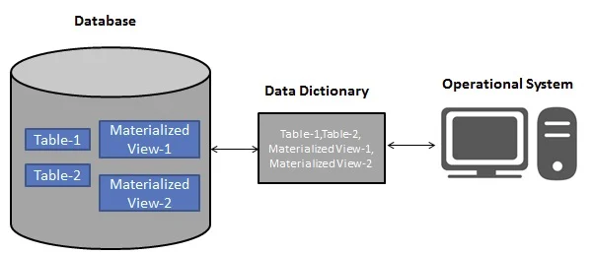
Materialized View

Slide 124
Efficient View Implementation
View materialization:
Involves physically creating and keeping a temporary table
Assumption:
Other queries on the view will follow
Concerns:
Maintaining correspondence between the base table and the view when the base table is updated
Strategy:
Incremental update

Slide 125
Update Views
Update on a single view without aggregate operations:
Update may map to an update on the underlying base table
Views involving joins:
An update may map to an update on the underlying base relations
Not always possible

Slide 126
Un-updatable Views
Views defined using groups and aggregate functions are not updateable
Views defined on multiple tables using joins are generally not updateable
WITH CHECK OPTION: must be added to the definition of a view if the view is to be updated
To allow check for updatability and to plan for an execution strategy

Slide 127
Database Stored Procedures
Persistent procedures/functions (modules) are stored locally and executed by the database server
As opposed to execution by clients
Advantages:
If the procedure is needed by many applications, it can be invoked by any of them (thus reduce duplications)
Execution by the server reduces communication costs
Enhance the modeling power of views
Disadvantages:
Every DBMS has its own syntax and this can make the system less portable

Slide 128
Stored Procedure Constructs
A stored procedure
CREATE PROCEDURE procedure-name (params)
local-declarations
procedure-body;
A stored function
CREATE FUNCTION fun-name (params) RETRUNS return-type
local-declarations
function-body;
Calling a procedure or function
CALL procedure-name/fun-name (arguments);

Slide 129
END OF MODULE 2

